Slide 1
Clustering Neighborhoods in Ottawa and Toronto
Valentín Irazabal

Slide 2
Introduction
This project will intend to approach the resolution of a common problem for many Canadians: not knowing which neighborhood would suit them better when moving or travelling from Ottawa (the country's administrative capital) to Toronto (Ontario´s state capital as well as the country´s financial centre and most populated city).
Since these two cities could be considered to be the country´s "top two", and given their proximity, Canadians living in one or the other may have to often visit the other city either for financial or administrative purposes.
The aim of the project is to group similar neighborhoods in both cities into clusters in order to allow anyone to recognize which neighborhoods are more similar to their own in the other city.

Slide 3
Problem
Ottawa and Toronto are two large multicultural cities that can have very different neighborhoods, still, they are vastly interconnected since they are one the country´s administrative capital and the other the economic capita. The problem to solve will be in which Toronto neighborhood would someone coming from any Ottawa neighborhood fell more at home.

Slide 4
Data
Two main sources of Data were used: first the Wikipedia pages on postal codes from Toronro and from Ottawa, from where I will use BeautifulSoup to obtain Postal Codes From the different boroughs, which will then be very usefull to use the geocoder API in order to obtain their geospatial coordinates.
This information will be then usefull to obtain the neighborhoods' venues by using the Foursquare API.
Finally, once I obtain the venues I will be able to cluster the naighborhoods from both cities into clusters, in order to recognize which of them are similar to one another.

Slide 5
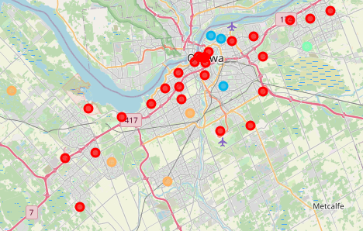
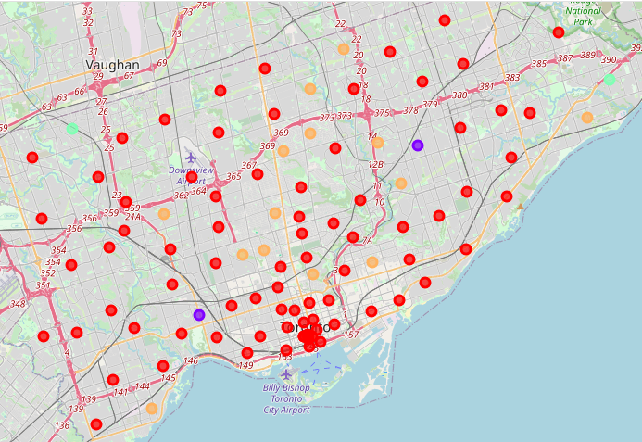
Clusters Obtained

Slide 6
Discussion
This can be a useful approach for travellers and people who move within these two cities. On top of this, the same methodology may be applied to any other city of the world, using the same Foursquare API. This has the potential to allow any traveller to feel “at home” when visiting any spot in the world by simply choosing wisely the neighborhood.
This methodology carries some limitations, for example, the most amount of clusters were used until clusters with only one observation appeared, still, some of the clusters contain up to a hundred observations which is, from my point of view, too generic. Furthermore, there is a cluster unique to each city, meaning that people living in the neighborhoods contained in this clusters would be unable to find their corresponding in the other city.

Slide 7
Conclusion
In this study I obtained information from two different cities in Canada and was able to group them into clusters using their venues as criteria. This successfully fulfilled the purpose of obtaining similar and dissimilar neighborhoods in both cities.
Although this analysis may have some limitations, I consider this approach to be interesting to extrapolate to every city in the world, allowing anyone to know which neighborhood will they be the most familiar with when travelling or moving.

